Slide 1
Price Discrimination

Slide 2
Price Discrimination
What is price discrimination?
Conditions for Price Discrimination
Types of Price Discrimination
Welfare effects of Price Discrimination
How is price discrimination practiced?

Slide 3
Price Discrimination
Price discrimination occurs when a firm sells the same good at different prices to different group of customers.
To practice price discrimination a firm must be a price maker. It must have some market power before it can charge more than one price.
Both monopolies and non monopoly companies use price discrimination to earn higher profits.
Can Competitive firm practice price discrimination?
Examples: Movie theatre tickets, college tuition, air line reservations, discounts on academic software and coupons

Slide 4
Conditions for Price Discrimination
Distinguishing groups of buyers
With different elasticity of demand –Consumers with elastic demand and consumers with inelastic demand
Preventing resale
For price discrimination to be viable strategy a firm must be able to prevent resale of the product or service.

Slide 5
Types of Price Discrimination
First Degree Price Discrimination
Firm would like to charge a different prices to each of its customers. If it could, it would charge each customer the maximum price that the customer is willing to pay for each unit bought. We call this maximum price the customer’s reservation price. The practice of charging each customer his or her reservation price is called perfect price discrimination or First degree price discrimination.
Second Degree Price Discrimination
Practice of charging different prices per unit for different quantities of the same good or service. Eg. Electricity tariff rates
Third Degree Price discrimination
Practice of dividing consumers into two or more groups with separate demand curves and charging different prices to each group.
Eg. Discounts to students and senior citizens.

Slide 6
Tamil Nadu’s New electricity tariff
Bi-Monthly Consumption | Units Charged For | Charge per Unit (Rs) | Energy Charges (Rs) | Fixed Charges (Rs) | Total Charges Payable (Rs)
120 | 20 | 20*1.5 | 30 | 20 | 50
160 | 60 | 60*1.5 | 90 | 20 | 110
200 | 100 | 100*1.5 | 150 | 20 | 170
300 | 200 | 100* 2 100*3 | 500 | 30 | 530
500 | 400 | 100*2 300*3 | 1100 | 30 | 1130
800 | 700 | 100*3.5 300*4.6 300*6.6 | 3710 | 50 | 3760

Slide 7
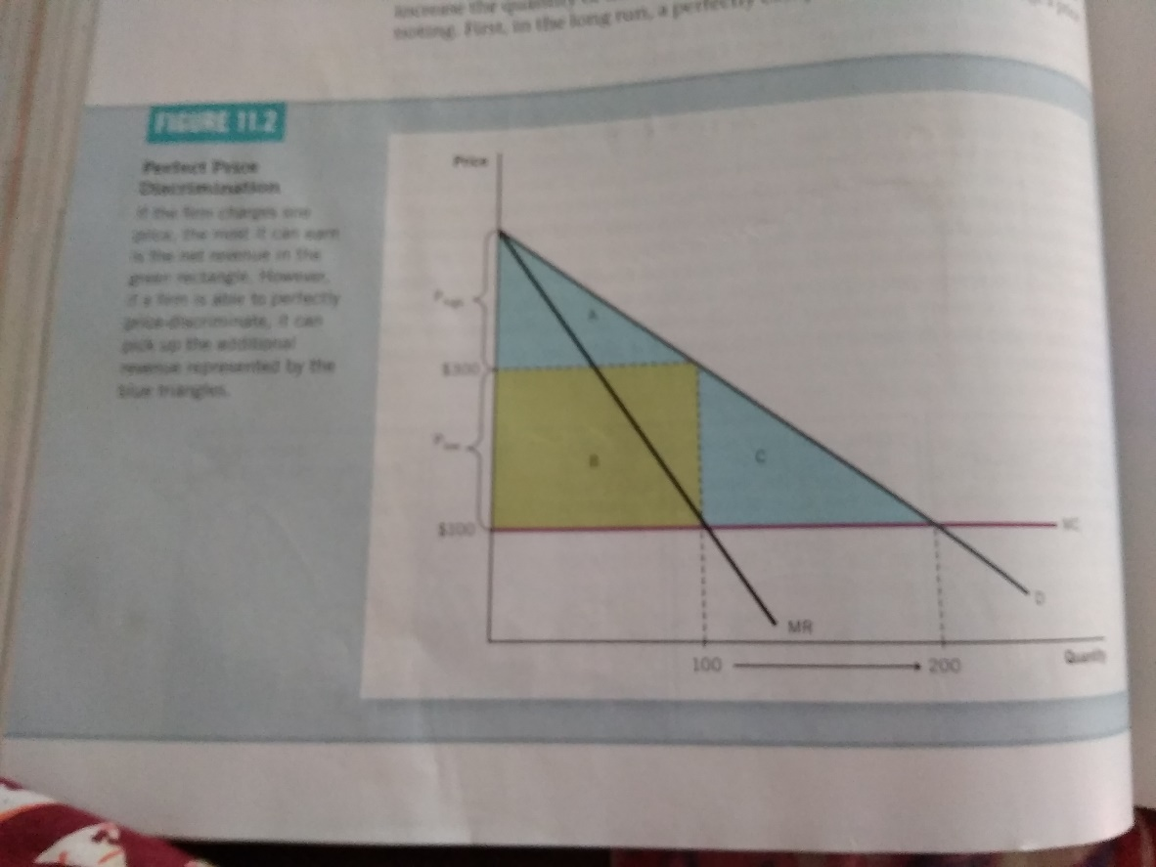
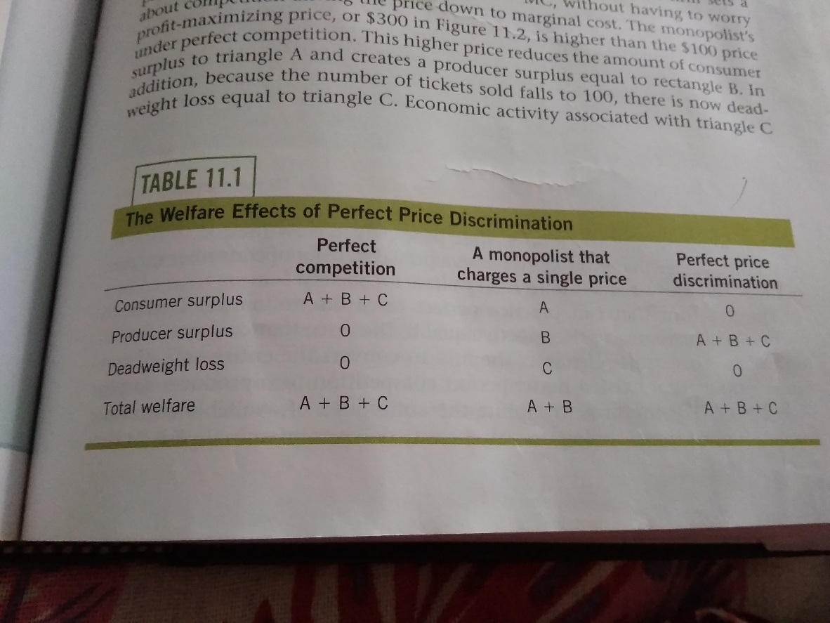
Welfare effects of price discrimination
Perfect Price Discrimination
Comparison

Slide 8
Imperfect Price Discrimination
Does not know the reservation price of each customer. Firms can discriminate imperfectly by charging a few different prices based on estimates of customers ‘ reservation prices.
Used by professionals like doctors, lawyers, accountants or architects.

Slide 9
How Price Discrimination is Practiced?
Movie tickets
Airline prices
Discount coupons
Financial aid
Quantity discounts

Slide 10
Peak load Pricing
Peak Load pricing involves charging different prices at different points in times.
For Some goods and services demand peaks at particular times. For eg.roads and tunnels during rush hour, electricity during summer, amusement parks on weekends.

Slide 11
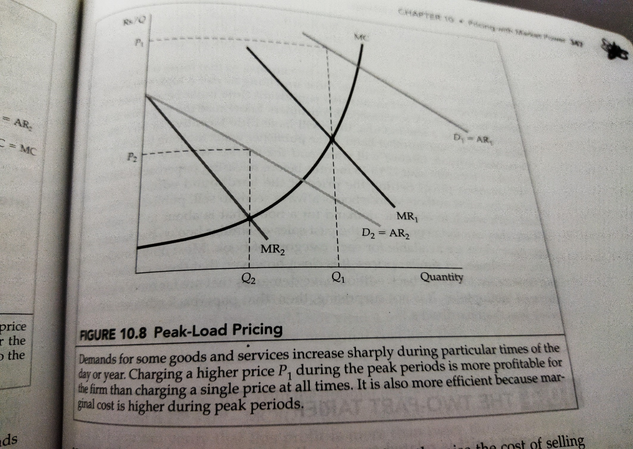

Slide 12
Bundling
Bundling is the practice of selling two or more products together for a single price.
When the products are available as a package, the pricing strategy is referred to as pure bundling.
If at least some products can also be purchased separately, then the firm is using mixed bundling.
Eg. MacDonald's Value meals
Automobiles with features like AC, sun roofs and geographical systems.
computer package complete with a monitor, mouse, keyboard, and preloaded software for a single price.
Industries which use bundling practices include telecommunications services, software and computer companies, journal publishers, automobiles, vacation packages, and fast food restaurants, to

Slide 13
Transfer Pricing
Many firms are vertically integrated-they contain several divisions with some divisions producing parts and components that other divisions use to produce finished product.
For eg. Automobile companies have upstream divisions that produce engines, brakes, radiators and other components.
Downstream divisions use to produce the finished cars.
Transfer pricing are valuation of these parts and components within the firm.
Transfer prices are internal prices at which parts and components from upstream divisions are sold to down stream divisions.

